Slide 1
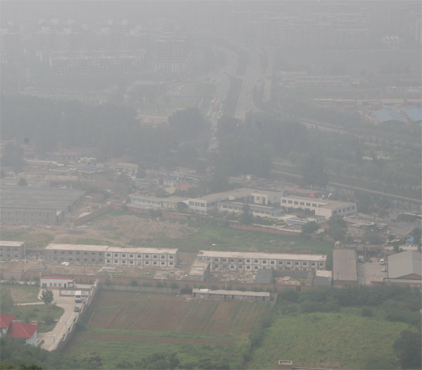
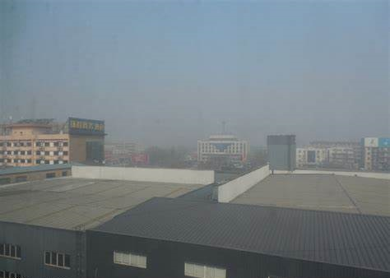
Haze Removal
Without Haze
？
吴德明
2019232111

Slide 2
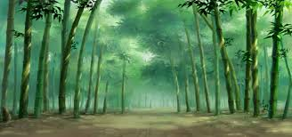
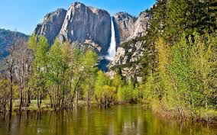
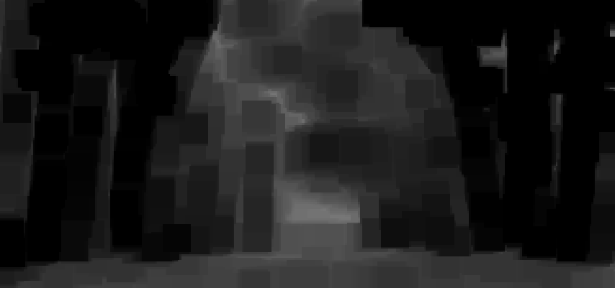
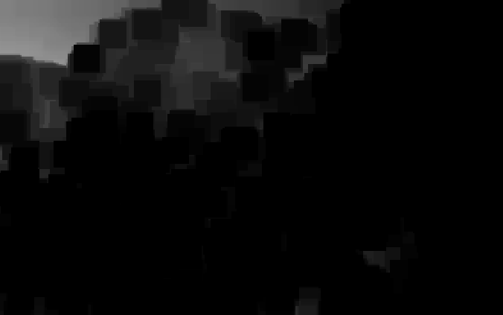
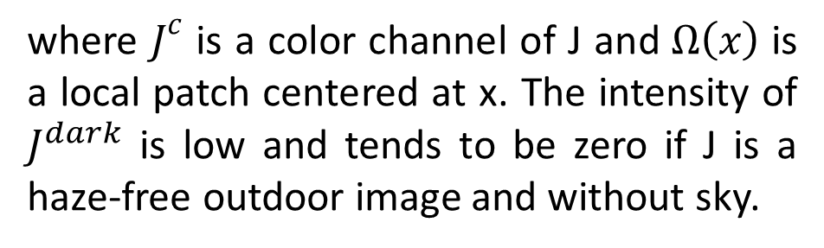

Method
Dark Channel Prior
$$J^{dark}\left(x\right)=\min_{\left.c∈\{r,g,b\right\}}\left(\min_{y∈Ω\left(x\right)}{{\left(J\right.}^{c}\left(y\right)})\right)$$
where $J^{c}$ is a color channel of J and$Ω\left(x\right)$ is a local patch centered at x. The intensity of $J^{dark}$ is low and tends to be zero if J is a haze-free outdoor image and without sky.

Slide 3
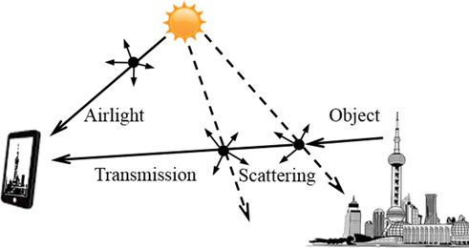
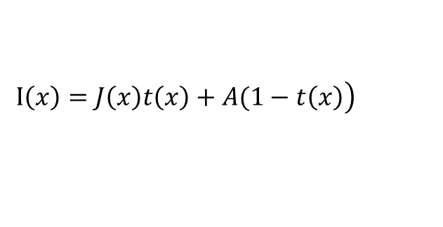
Method
Haze Removal Background
$$\left.I\left(x\right)=J\left(x\right)t\left(x\right)+A(1−t\left(x\right)\right)$$
where I(x) is the observed intensity, J(x) is the scene radiance, A is the global atmospheric light, and t(x) is the medium transmission describing the portion of the light that is not scattered and reaches the camera. The goal of haze removal is to recover J(x), A, and t(x) from I(x).

Slide 4
Method
Haze Removal Using Dark Channel Prior
Estimating the Atmospheric Light
1、the top 0.1% brightest pixels in the dark channel are picked.
2、Among these pixels, the pixels with highest intensity
in the input image I is selected as the atmospheric light.

Slide 5
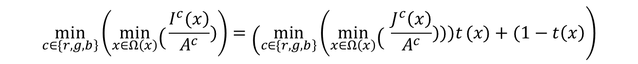
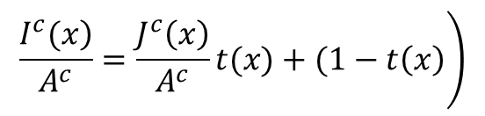
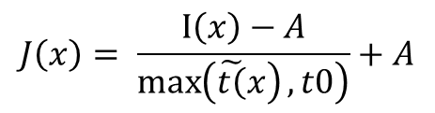
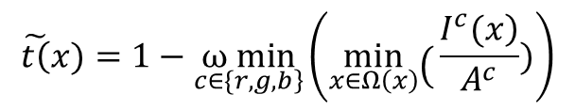
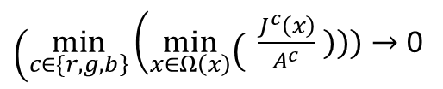
Method
Haze Removal Using Dark Channel Prior
Estimating the Transmission and Recovering
$$\left.\frac{\left.I^{c}(x\right)}{A^{c}}=\frac{J^{c}\left(x\right)}{A^{c}}t(x)+(1−t\left(x\right)\right)$$
$$\left.\min_{\left.c∈\{r,g,b\right\}}\left(\left.\min_{x∈Ω\left(x\right)}\right({\frac{\left.I^{c}(x\right)}{A^{c}}})\right)=\left(\min_{\left.c∈\{r,g,b\right\}}\right.\left(\left.\min_{x∈Ω\left(x\right)}\right({ \frac{J^{c}\left(x\right)}{A^{c}}})))t\right.(x)+(1−t\left(x\right)\right)$$
$\left(\min_{\left.c∈\{r,g,b\right\}}\right.\left(\left.\min_{x∈Ω\left(x\right)}\right({ \frac{J^{c}\left(x\right)}{A^{c}}} )))→\right.$ 0
$$\tilde{\left.t\right(}x)=1−\underset{\left.c∈\{r,g,b\right\}}{ω min}\left(\left.\min_{x∈Ω\left(x\right)}\right({\frac{\left.I^{c}(x\right)}{A^{c}}})\right)$$
$$J\left(x\right)= \frac{I\left(x\right)−A}{\left.\max\left(\tilde{\left.t\right(}x\right),t0\right)}+A$$

Slide 6
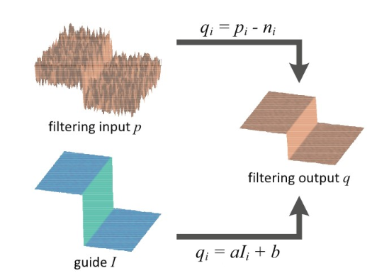
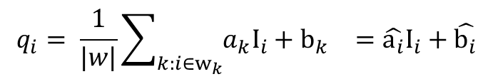
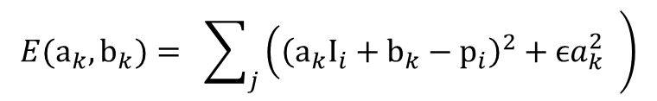
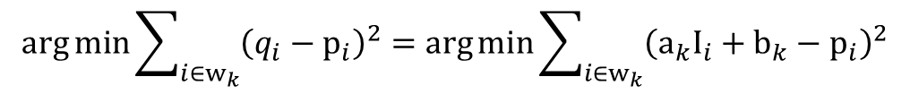

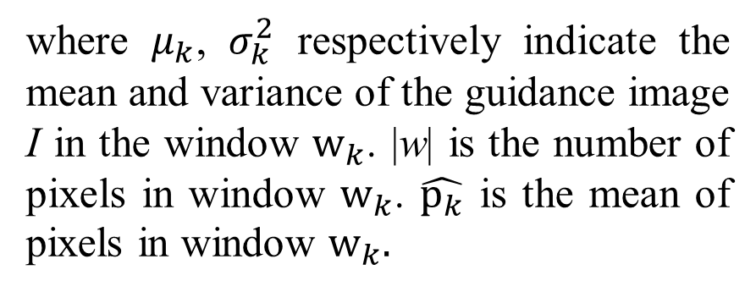

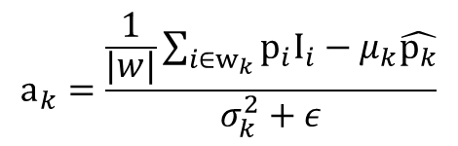
Method
Guided Filter
$$q_{i}= a_{k}I_{i}+b_{k}, ∀i∈w_{k}$$
$$\arg{\min{\sum_{i∈w_{k}}{{\left(q_{i}−p_{i}\right)}^{2}}}}=\arg{\min{\sum_{i∈w_{k}}{{\left(a_{k}I_{i}+b_{k}−p_{i}\right)}^{2}}}}$$
$$\left.E(a_{k},b_{k})= \sum_{j}{\left({\left(a_{k}I_{i}+b_{k}−p_{i}\right)}^{2}+ϵa_{k}^{2}\right.} \right)$$
where $μ_{k}$, $σ_{k}^{2}$ respectively indicate the mean and variance of the guidance image I in the window $w_{k}$. |w| is the number of pixels in window $w_{k}$. $\hat{p_{k}}$ is the mean of pixels in window $w_{k}.$
$$a_{k}=\frac{\frac{1}{|w|}\sum_{i∈w_{k}}{p_{i}I_{i}−μ_{k}\hat{p_{k}}}}{σ_{k}^{2}+ε}$$
$$b_{k}=\hat{p_{k}}−a_{k}μ_{k}$$
$$q_{i}= {\frac{1}{|w|}\sum_{k:i∈w_{k}}{{a_{k}I}_{i}+b_{k}}}_{}=\hat{a_{i}}I_{i}+\hat{b_{i}}$$

Slide 7
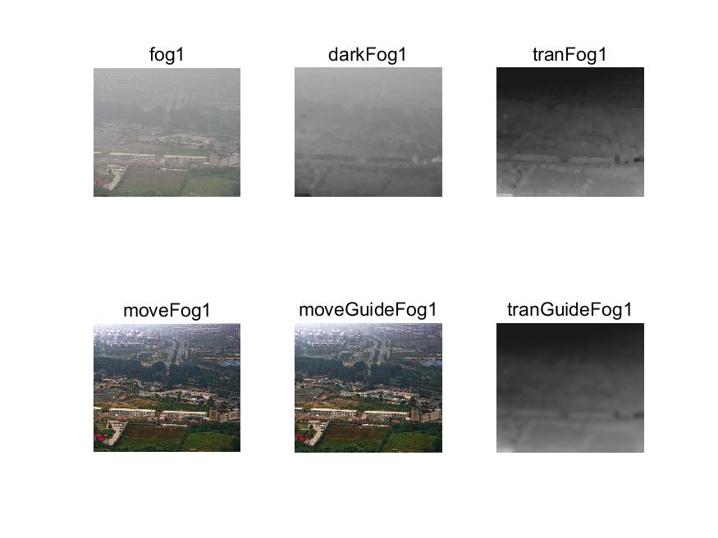
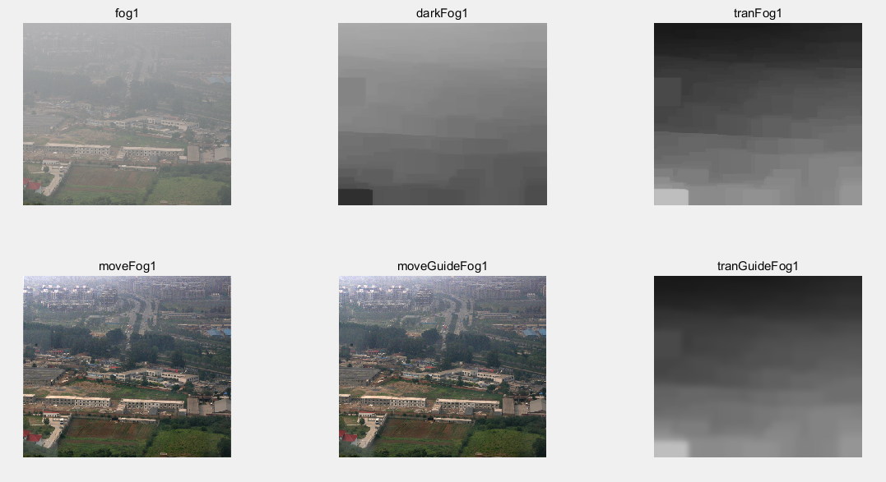
Result
Getting dark channel image uses window’s radius 30, and use 8 as guided filter’s radius.
Getting dark channel image uses window’s radius 7, and use 8 as guided filter’s radius.

Slide 8
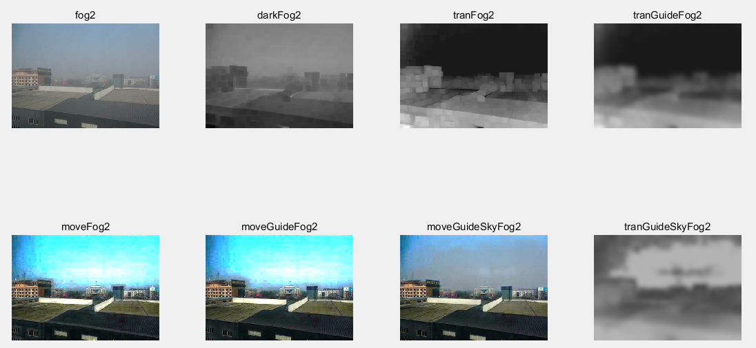

min(max(1,k/abs( (I(x))-A))*t(x) ,t1)
Getting dark channel image uses window’s radius 7,
and use 8 as guided filter’s radius.
Getting dark channel image uses window’s radius 7,
and use 4 as guided filter’s radius.

Slide 9
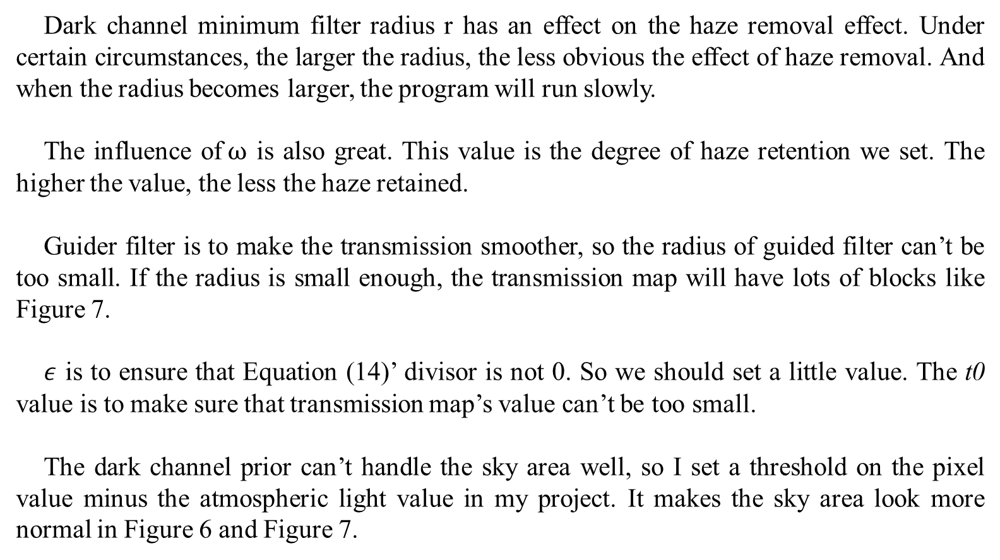
Discussion
Dark channel minimum filter radius r has an effect on the haze removal effect. Under certain circumstances, the larger the radius, the less obvious the effect of haze removal. And when the radius becomes larger, the program will run slowly.
The influence of$ω$ is also great. This value is the degree of haze retention we set. The higher the value, the less the haze retained.
Guider filter is to make the transmission smoother, so the radius of guided filter can’t be too small. If the radius is small enough, the transmission map will have lots of blocks like Figure 7.
$ε$ is to ensure that Equation (14)’ divisor is not 0. So we should set a little value. The t0 value is to make sure that transmission map’s value can’t be too small.
The dark channel prior can’t handle the sky area well, so I set a threshold on the pixel value minus the atmospheric light value in my project. It makes the sky area look more normal in Figure 6 and Figure 7.

